Slide 1
Capstone Project
The Battle of Neighborhoods Opening Chinese Restaurant in Toronto
Carol Wang

Slide 2
Business Understanding/Problem Description
Objective: In this project, we will find the best neighborhood in Toronto for opening a new Chinese restaurant.
There are some questions we need to address:
People live in which neighborhood likely eat in this kind of restaurant?
How many "similar" restaurants are available nearby?
Do the "similar" restaurants cost more? If so, what specialty do that have?

Slide 3
Data Source
List of postal code for communities in Toronto from Wikipedia:
https://en.wikipedia.org/wiki/List_of_postal_codes_of_Canada:_M
Geospatial Coordinates CSV file for Toronto postal codes from http://cocl/us/Geospatial_data
Foursquare API venues explore methods to get venues of given neighborhoods
Foursquare API venues methods to get ranks and likes of restaurants by given venue id

Slide 4
Methodology
I will use of demographic data by neighborhoods, which allows me to gauge people’s taste in each neighborhood. For example, I assume areas with a majority of Chinese people would be prefer to go to Chinse restaurant.
I will use the Foursquare API to explore neighborhoods in Toronto and apply the explore function to get the most common venue categories in each of the neighborhoods.
I will then use this feature to group the neighborhoods into clusters and use the k-means clustering algorithm to refine the groupings.
Finally, I will use the Folium library to visualize the neighborhoods in Toronto and their emerging clusters as well as push the right neighborhood for setting up the restaurant business.

Slide 5
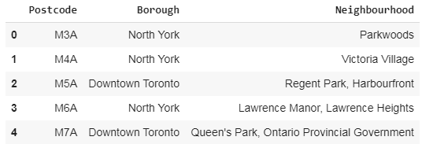
Data Cleaning:
I will use BeautifulSoup library to scrape Wikipedia to list of postal codes for each community. Remove the empty data in each row and group each zip code with all neighborhoods:

Slide 6
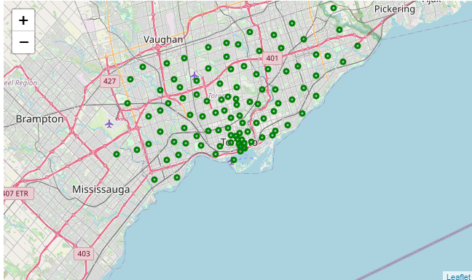
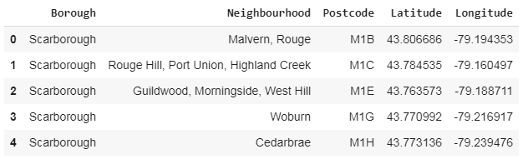
Data Cleaning:
Then geospatial data (coordinates) is read into pandas dataframe. Then joined with the previous dataframe to get a new dataframe with zip code, neighborhood, latitude, and longitude coordinates.

Slide 7
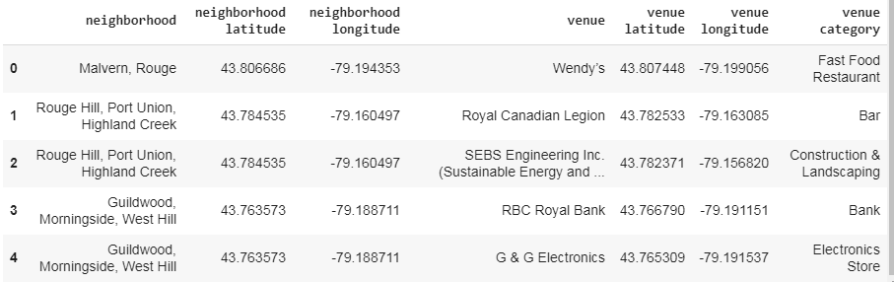
Foursquare API
I will use Foursquare API to explore neighborhoods and merge it to dataframe including neighborhoods and top-rated venues.

Slide 8
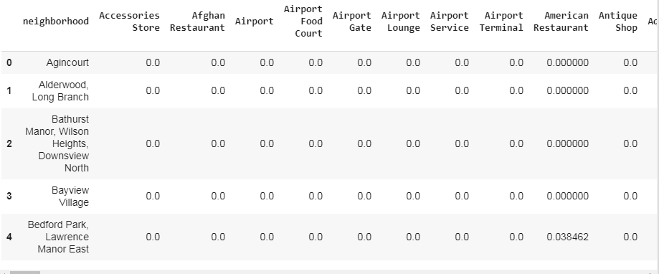
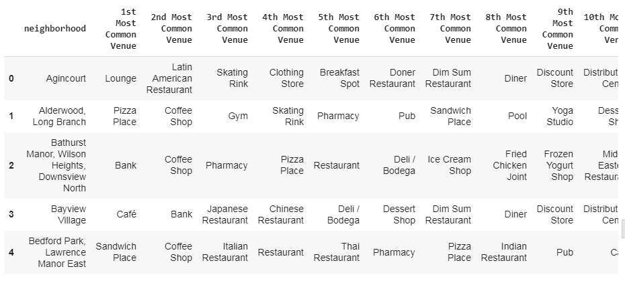
Features:
When extracting features from a dataset, it is often useful to transform categorical features into vectors. Then group them by neighborhood by taking the mean of the frequency of occurrence.

Slide 9
Clustering
In clustering, I try to find homogeneous subgroup within our data such that data points in each cluster are as similar as possible according to a similarity measure such as Euclidean-based distance or correlation-based distance.
Clustering is considered an unsupervised learning method since we don’t have the ground truth to compare the output of the clustering algorithm to the true labels to evaluate its performance. In this project, I use K-means clustering, which is a type of unsupervised learning, which is used when have unlabeled data. The K-means algorithm is an iterative algorithm that tries to partition the dataset into K pre-defined distinct non-overlapping subgroups where each data point belongs to only one group. In this case, the clustering is based on types of nearby venues.

Slide 10
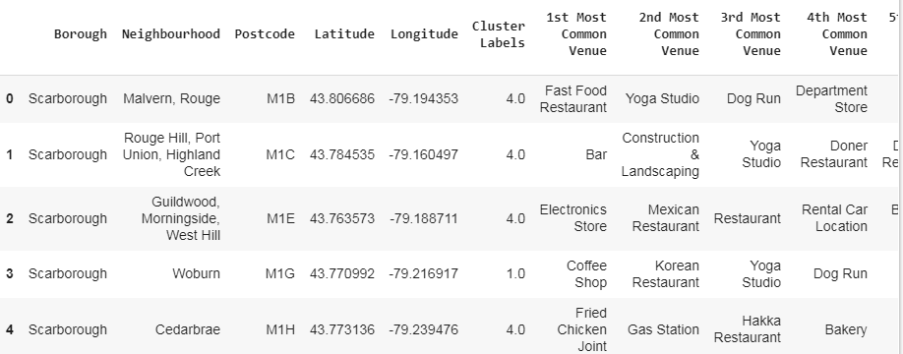
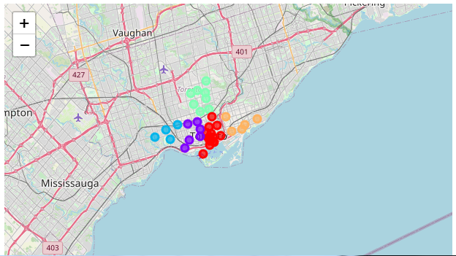
Clustering
Then data is grouped into 5 clusters. The clusters and the top 10 venues for each neighborhood are shown below:

Slide 11
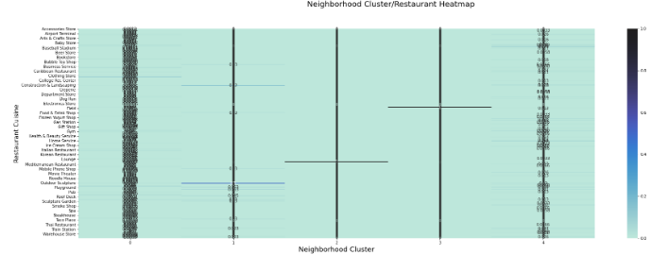
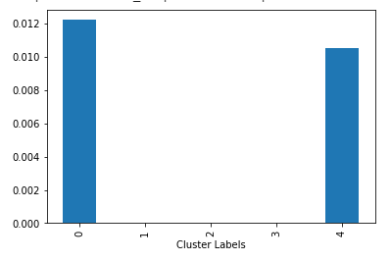
Discussion
Then dataset is grouped by clusters to get the means of the frequency occurrence of each cluster, and examined by a heatmap.

Slide 12
Conclusion
Conclusions can be taken from the previous maps, tables, and exploratory data analysis. For example, cluster 1 and 4 has high frequency of Chinese restaurants, so try not to open a new Chinese restaurant in cluster 1 or 4 neighborhoods.

